Slide 1

Spring of Code
Artificial Intelligence
(Machine Learning & Deep Learning)
Instructor
Asad Ullah
- Research Assistant (DIP Lab)
Duration
03 Months
(Feb – April)

Slide 2
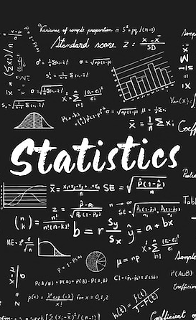
Day 04 – Descriptive Statistics
(Measure of Dispersion and Position)
Objectives:
What is Dispersion or Variability
Measures of Dispersion
Measures of Position

Slide 3
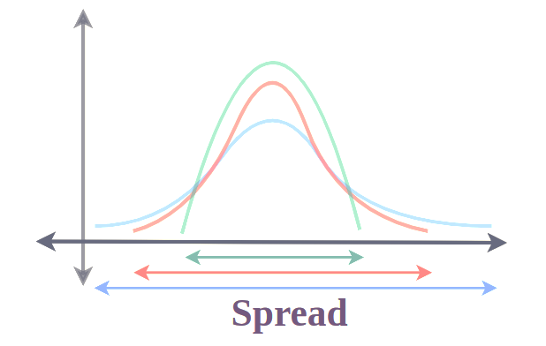
Dispersion
Dispersion is the spread or variability of the data points from the mean value
Notes:
"Imagine two archers. Both hit an average of 50m. But one always hits 49–51m. The other hits 10m to 90m. Same average, very different performance. Dispersion captures THAT difference."

Slide 4
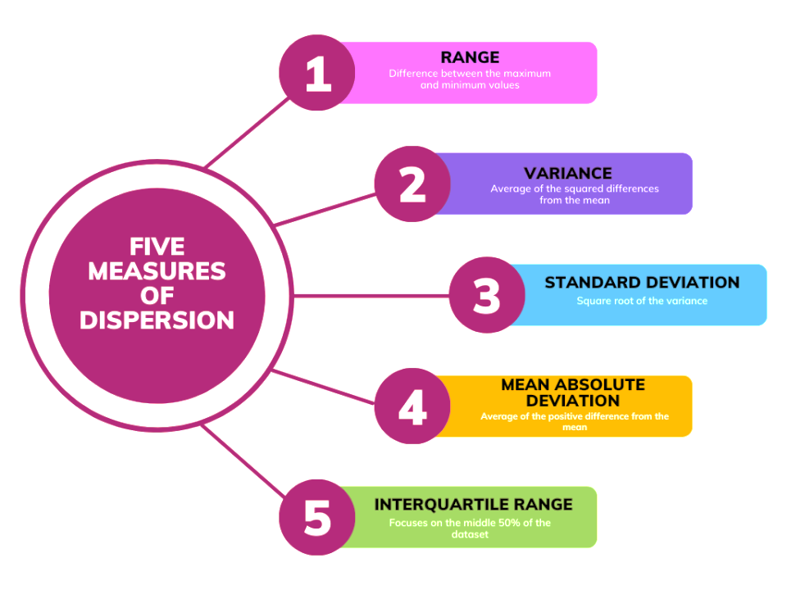

Slide 5
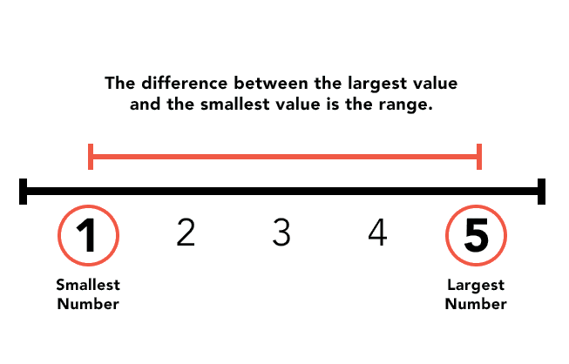
Range

Slide 6
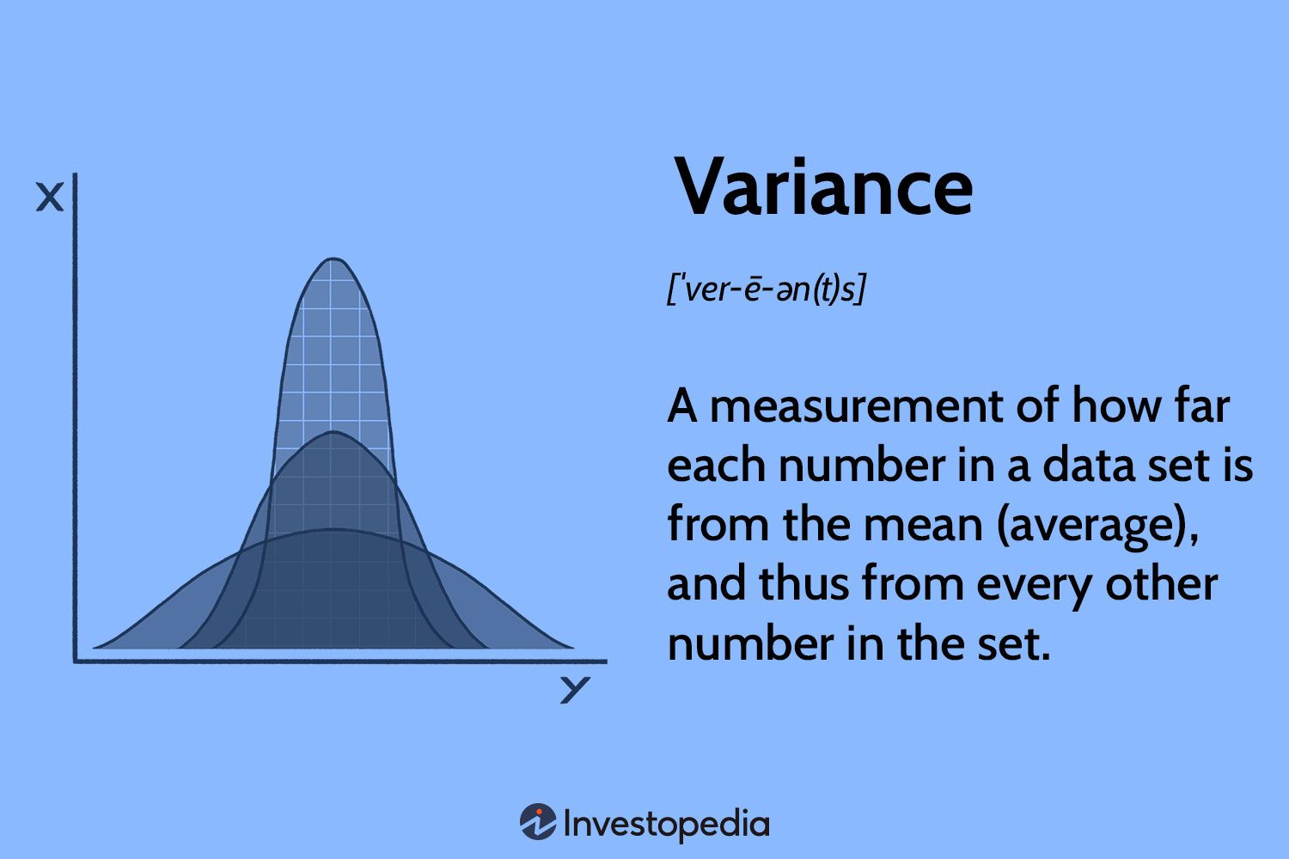
Variance

Slide 7
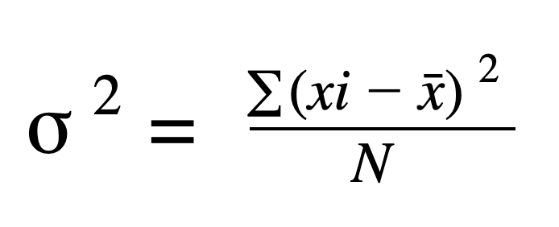
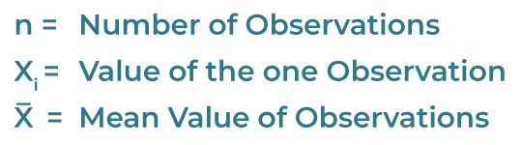
Calculating Variance
Variance =

Slide 8
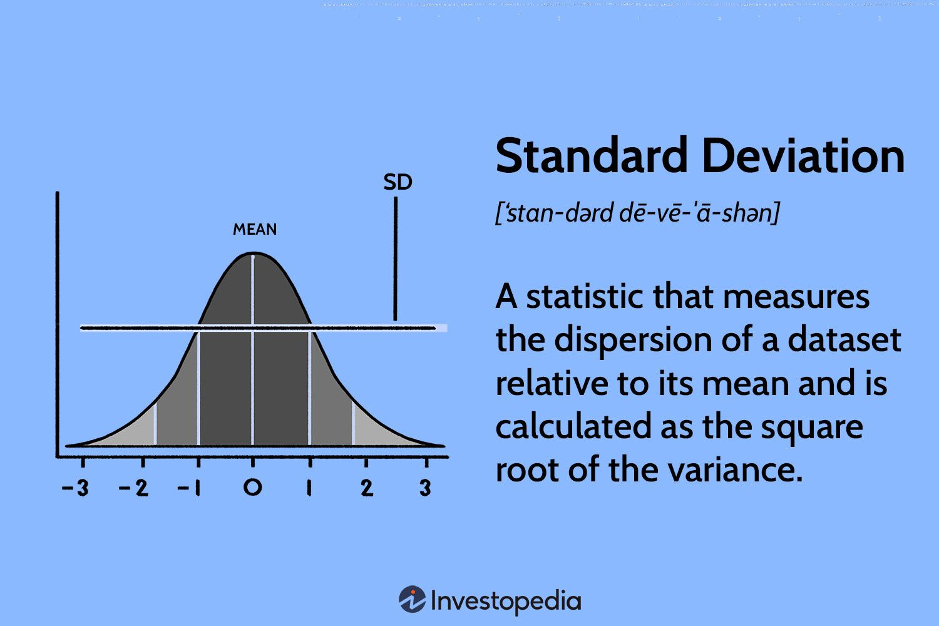
Calculating Variance
Notes:
Why SD is more useful than Variance in AI:
It's in the same unit as the data (interpretable)
Used directly in Z-score standardization
Used in Gaussian (Normal) distributions
Core to many ML metrics and loss functions

Slide 9
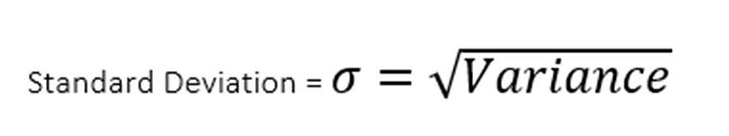
Calculating Standard Deviation

Slide 10
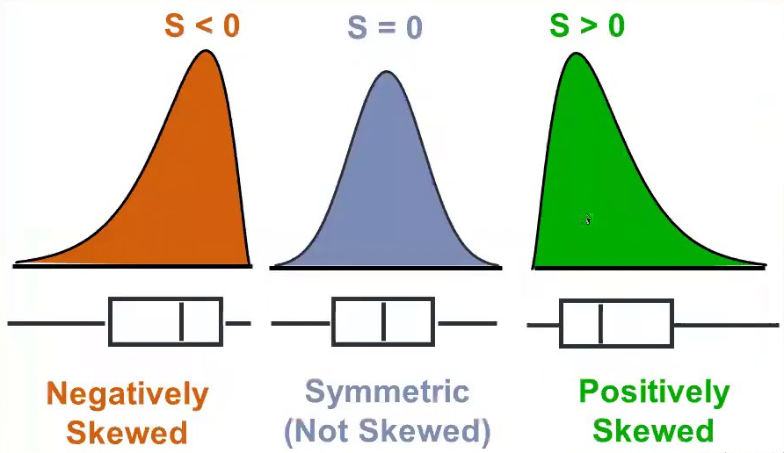
Skewness
Skewness is a measure of the asymmetry of the data distribution about its mean. The skewness value can be positive, zero, negative

Slide 11
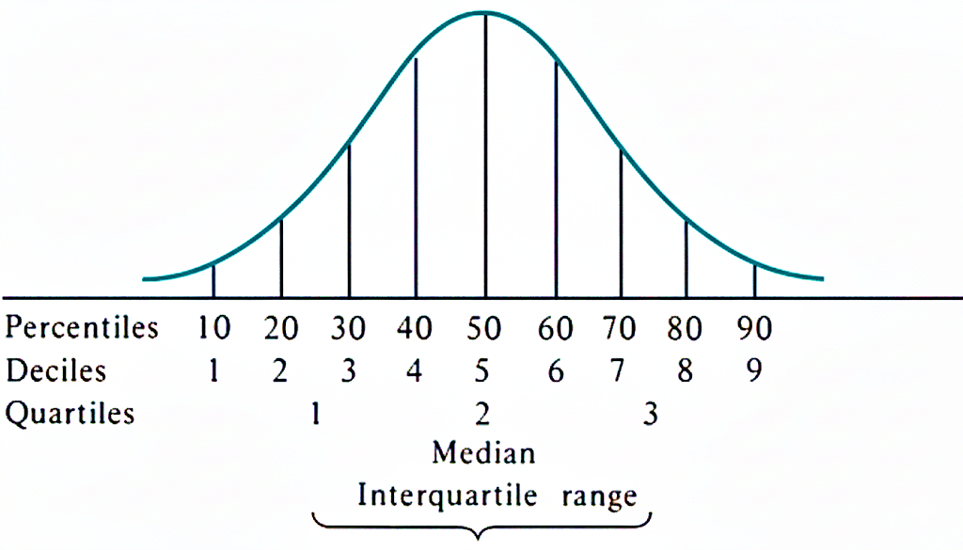
Measures of Position
Numerical measures that describe the standing or location of an observation relative to the rest of the data

Slide 12
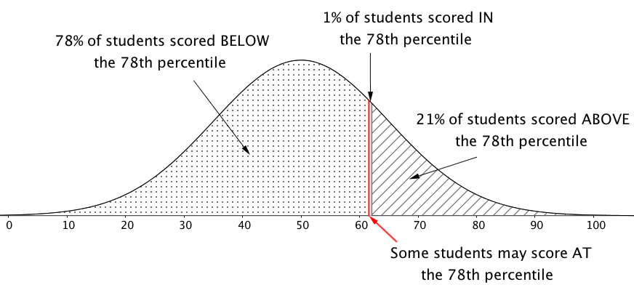
Percentile
Percentiles indicate the value below which a given percentage of observations in a dataset fall. For example, the 25th percentile (P₂₅) is the value below which 25% of the data points lie.

Slide 13
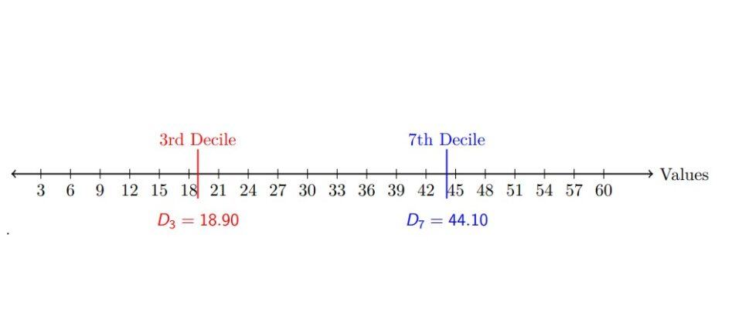
Decile
Deciles divide ranked data into 10 equal parts. Each part is called a decile.

Slide 14
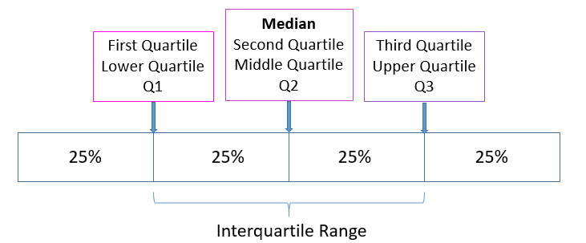
Quartile
Quartiles are values that divide a sorted dataset into four equal parts or quarters, each representing 25% of the data.

Slide 15
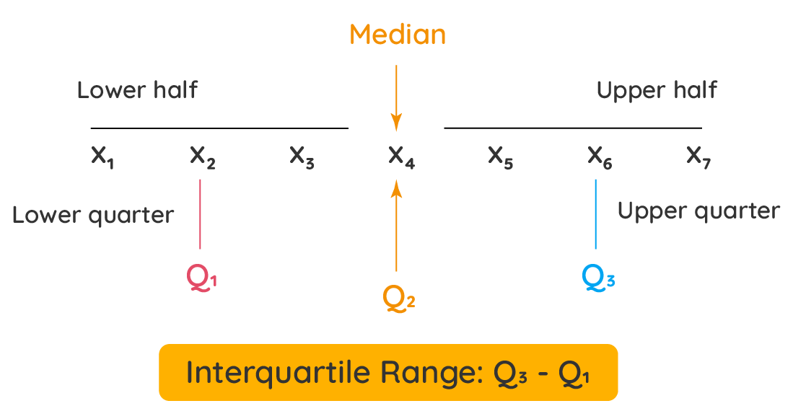
Interquartile Range
It is a measure of dispersion of data that represents the spread of the middle 50% of a dataset.

Slide 16
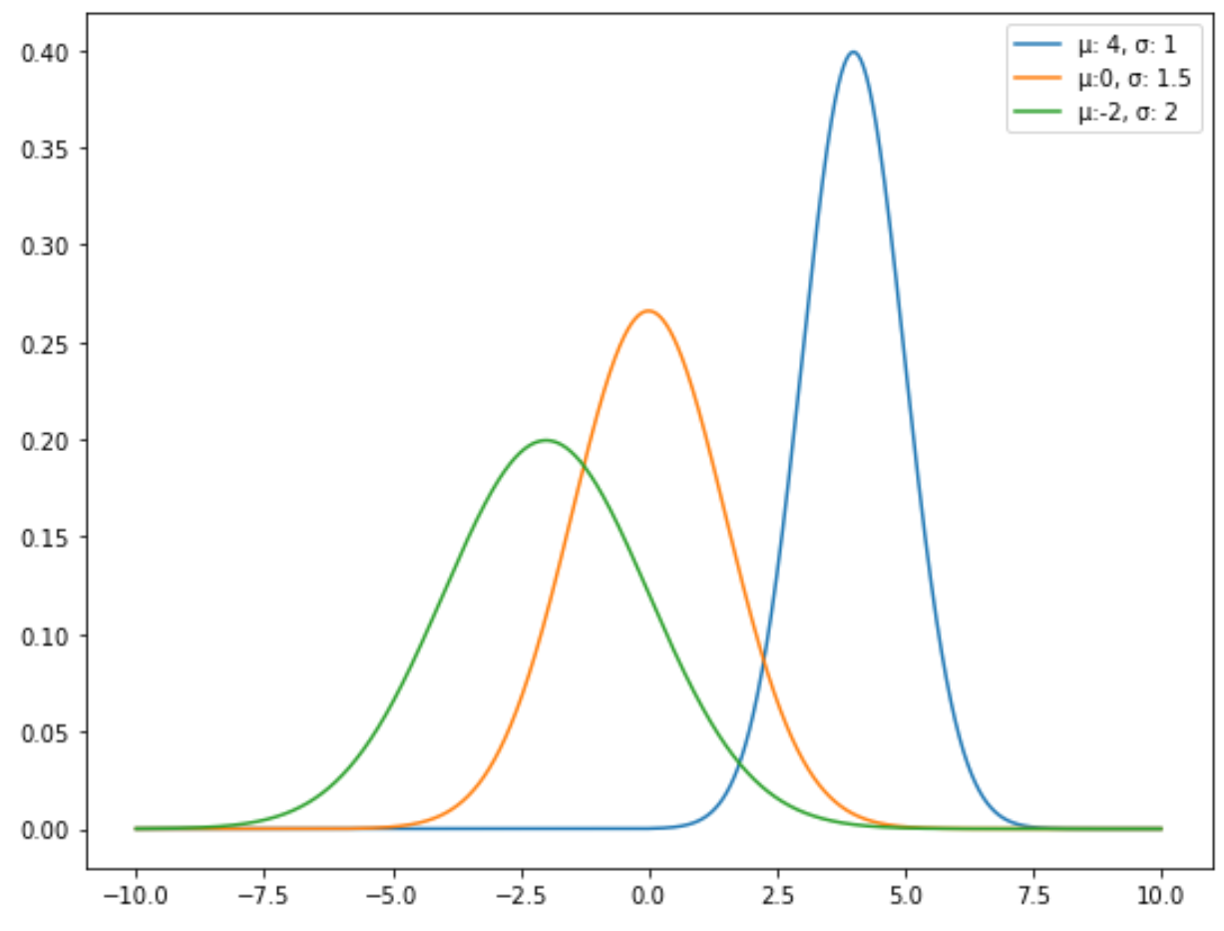
The Normal Distribution
Also know as Gaussian distribution or Bell Curve, is a continuous probability distribution that is symmetrical and bell-shaped, with data points clustering around the mean and decreasing symmetrically on either side.

Slide 17
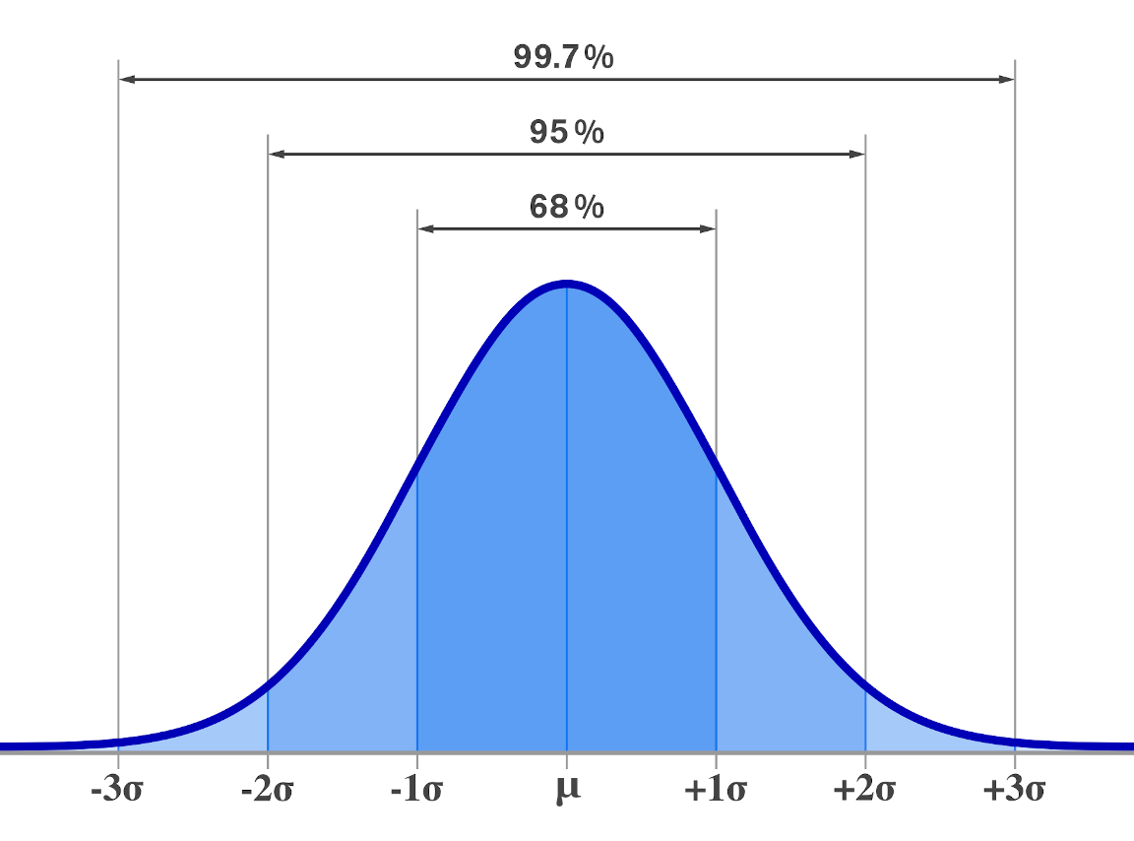
The 68-95-99.7% Rule
Approximately 68% of data falls within one standard deviation of the mean, 95% within two standard deviations, and 99.7% within three standard deviations

Slide 18
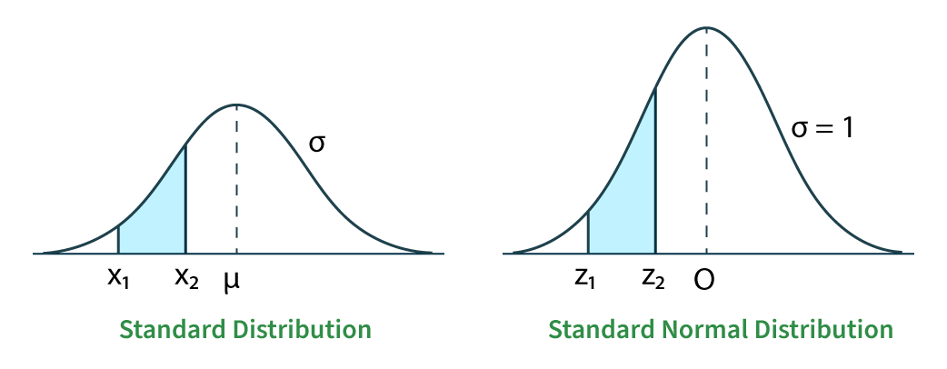
Standard Normal Distribution
It is a specific normal distribution with a mean of 0 and a standard deviation of 1, often used to compare normal distributions

Slide 19
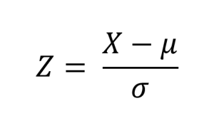
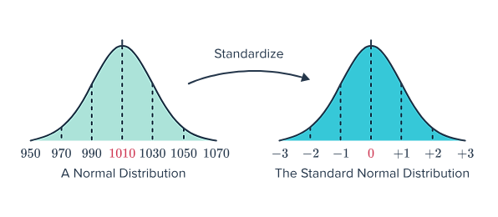
Standardization (Z-Scores)
The z-score indicates how many standard deviations a measurement is from the mean

Slide 20
Standard Normal Distribution
(Z-Scores)
The z-score indicates how many standard deviations a measurement is from the mean

Slide 21
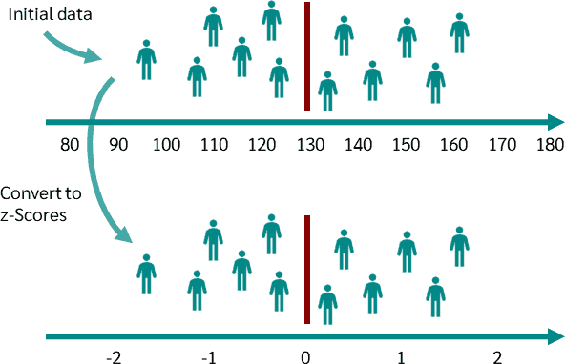
Standard Normal Distribution
(Z-Scores)
The z-score indicates how many standard deviations a measurement is from the mean

Slide 22

Thank You

